Slide 1
CogniShield: Edge-Based Adversarial Immunization and Signed Provenance for Digital Images
BITE497J – Project I | B.Tech. Information Technology
23BIT0030 – Rohit Kumar
23BIT0067 – Shivansh Rai
23BIT0241 – Aviral Bhan
Guide: Dr. Angulakshmi M
School of Computer Science Engineering and Information Systems, VIT Vellore | November 2026

Slide 2
Outline
The problem and why it matters
Objective, background, related work
Scope, threat model and goals
System design and algorithms
Provenance and the SD-Turbo test
Demonstration
Results on 14 images
Limitations, future work, conclusion
CogniShield | BITE497J Project I | VIT Vellore
2

Slide 3
The problem
A photo posted online can be copied and edited by anyone
Image-to-image diffusion models keep the person's face and pose but change the scene
A few lines of code, or one button, are enough
Most defences are detectors: they react after the fake already exists
The owner cannot make the original harder to misuse, or prove which file is theirs
CogniShield | BITE497J Project I | VIT Vellore
3

Slide 4
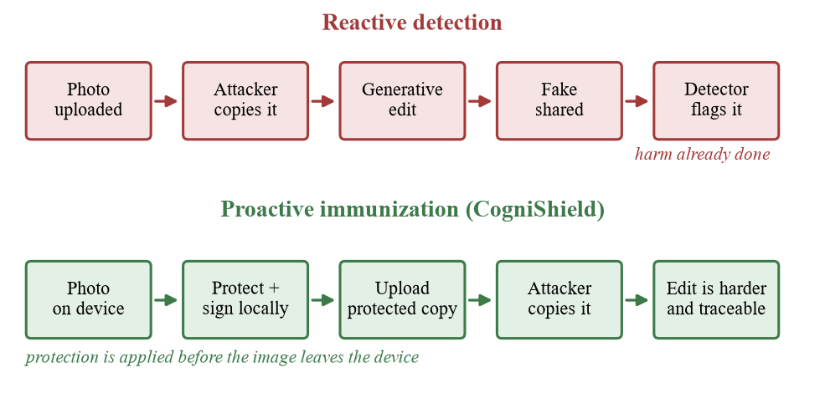
Reactive detection versus acting first
Detection: arms race with generators, works after harm is done
CogniShield: change the image slightly before upload and sign it
Everything runs on the user's own computer
CogniShield | BITE497J Project I | VIT Vellore
4

Slide 5
Objective
Build a local tool that protects an image and signs it. It should:
add a small, bounded, hard-to-see perturbation (at most 8 of 255 levels by default)
make that perturbation aware of JPEG compression
measure the quality cost: PSNR, SSIM, MSE, mean and max pixel change
sign the protected file with Ed25519 over a SHA-256 hash
optionally compare original and protected images through SD-Turbo
work from a web page and from the command line, without uploading anything
CogniShield | BITE497J Project I | VIT Vellore
5

Slide 6
Motivation
Easy tools. Open-weight models like SD-Turbo run on a home GPU in one to four steps.
Detection lags. Detectors are trained on old generators and weaken after resizing and recompression.
Privacy. Uploading a photo to a protection service sends the very image you worry about to someone else.
Learning value. Adversarial ML, cryptography and web engineering in one small, inspectable pipeline.
CogniShield | BITE497J Project I | VIT Vellore
6

Slide 7
Background
Editing with diffusion
Add noise to the photo, then denoise under a new prompt (SDEdit); "strength" sets how much changes
Adversarial perturbations
A change of at most ε per pixel can mislead a model; PhotoGuard uses this to resist editing
JPEG compression
8×8 DCT blocks; high-frequency detail is quantised away first, exactly where small perturbations live
Provenance
SHA-256 digest of the file, signed with Ed25519; any changed byte breaks verification
CogniShield | BITE497J Project I | VIT Vellore
7

Slide 8
Related work
Work | Idea | Difference from this project
PhotoGuard (2023) | Immunize images against diffusion editing by attacking the model | Needs model access and heavy compute
Fawkes (2020) | Cloak photos against face-recognition training | Different misuse: recognition
Glaze (2023), Anti-DreamBooth (2023), AdvDM (2023) | Protect style and personalised fine-tuning | Target training, not image-to-image editing
Shin & Song (2017) | JPEG-resistant adversarial images | We use the real JPEG encoder in a feedback loop
C2PA | Signed provenance manifests with certificates | We use a local key pair and a sidecar JSON
CogniShield | BITE497J Project I | VIT Vellore
8

Slide 9
Problem statement and scope
Given an image, produce a near-identical protected copy that differs by at most a small bound, is built to survive JPEG, has its quality cost measured, and whose exact bytes are signed. All of it runs locally.
In scope
Still images (PNG, JPG, WEBP, up to 200 MB)
Edge-aware perturbation with JPEG feedback
Metrics and JPEG tests at 95/85/75/60/50
Ed25519 signing and verification
Optional SD-Turbo comparison
Out of scope
Video and audio
Gradient optimisation against a model
Guarantees against cropping, screenshots, print-and-scan
Certificate authority / PKI
Human perceptual study
CogniShield | BITE497J Project I | VIT Vellore
9

Slide 10
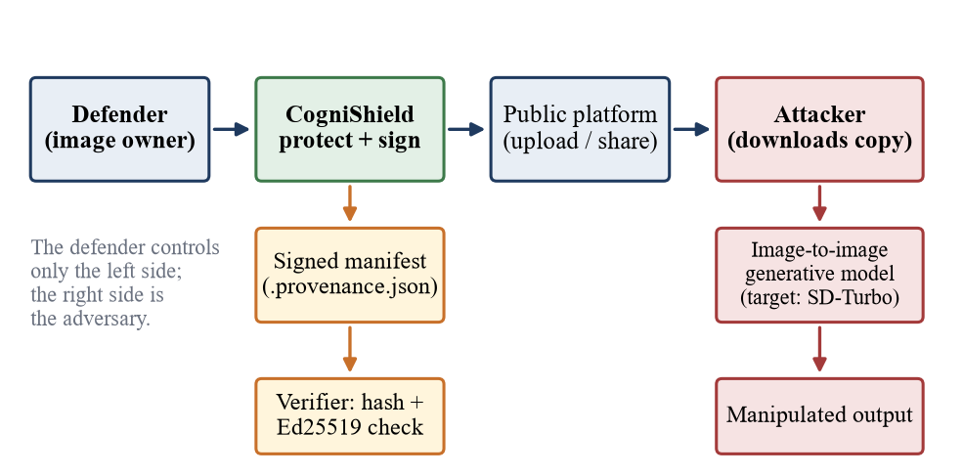
Threat model
Attacker downloads the published image and runs image-to-image generation
Attacker can recompress with JPEG
Attacker cannot forge a signature without the private key
We claim integrity of the file and a measured change, not immunity
CogniShield | BITE497J Project I | VIT Vellore
10

Slide 11
Goals and how they are checked
ID | Goal | Acceptance criterion
G1 | Imperceptible protection | PSNR above 30 dB, SSIM close to 1.0
G2 | Bounded change | Max pixel change never exceeds the budget
G3 | Compression awareness | Tested at JPEG 95, 75, 50; effect of feedback measured
G4 | Reproducibility | Same image, seed, settings: identical output
G5 | Verifiable provenance | Valid for the file, fails if one byte changes
G6 | Target-model comparison | Original and protected through SD-Turbo, side by side
G7 / G8 | Usability, local operation | Browser workflow; server on 127.0.0.1 only
CogniShield | BITE497J Project I | VIT Vellore
11

Slide 12
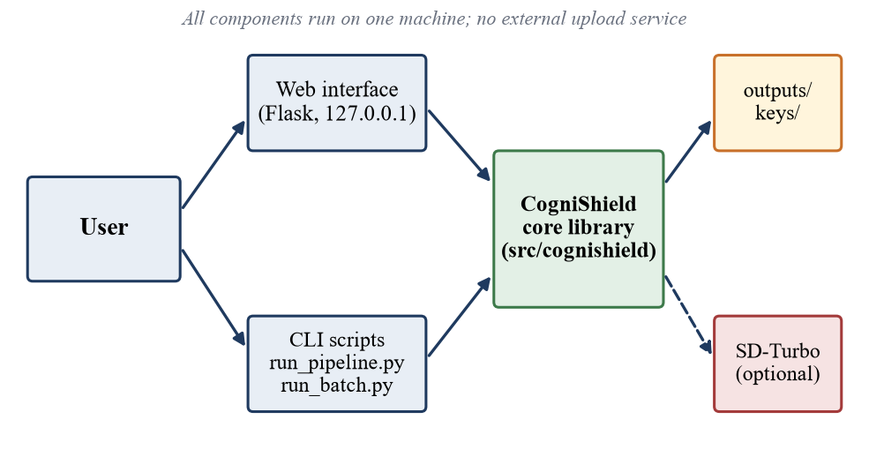
System overview
Core library of six small modules
Flask web page and two command-line programs
Outputs and keys stay in project folders
SD-Turbo is optional
CogniShield | BITE497J Project I | VIT Vellore
12

Slide 13
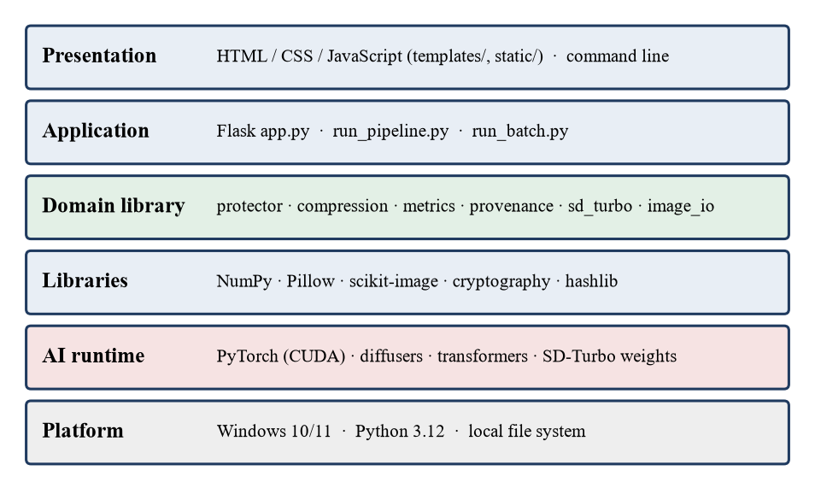
Software architecture
protector: noise, edge mask, feedback loop
compression: JPEG round trips
metrics: PSNR, SSIM, MSE, deltas
provenance: hash, sign, verify
sd_turbo: optional model runner
About 430 lines of Python in the library
CogniShield | BITE497J Project I | VIT Vellore
13

Slide 14
Technical specification
 | Core protection | SD-Turbo test (optional)
Hardware | Any 64-bit CPU, 4 GB RAM | NVIDIA GPU with CUDA
Software | Windows 10/11, Python 3.12 | PyTorch (CUDA 12.8), diffusers
Libraries | NumPy, Pillow, scikit-image, cryptography, Flask | transformers, accelerate, huggingface_hub
Disk | About 2 GB packages, about 5 MB per run | Several GB for the model
Interfaces | Web at 127.0.0.1:5000; run_pipeline.py; run_batch.py | Tick-box in the web page
CogniShield | BITE497J Project I | VIT Vellore
14

Slide 15
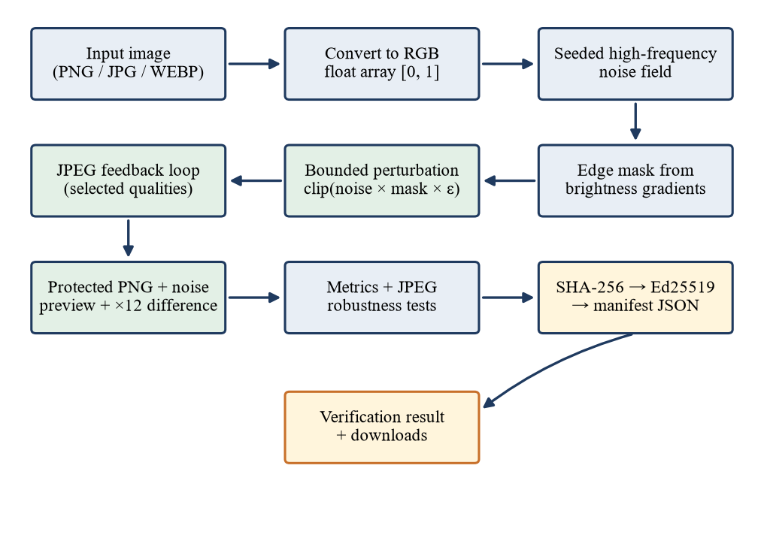
Processing pipeline
Image is converted to RGB floats in [0, 1]
Seeded noise × edge mask × budget
JPEG feedback refines it
Protected PNG, noise preview, difference ×12
Metrics, JPEG tests, then hash and signature
CogniShield | BITE497J Project I | VIT Vellore
15

Slide 16
Noise and edge mask
High-frequency noise. Seeded Gaussian noise ξ minus a blurred copy, scaled by its largest value: n = (ξ − G(ξ)) / max|…|
Edge mask. Gradient of the grey image, normalised to g in [0, 1]: m = (1 − w) + w · g, with w = 0.65, so flat areas still get 35%
Bounded start. δ0 = clip(n · m · ε, −ε, +ε), where ε = E/255 and E is 1 to 16 (default 8)
Same seed gives the same noise, so every run can be repeated
CogniShield | BITE497J Project I | VIT Vellore
16

Slide 17
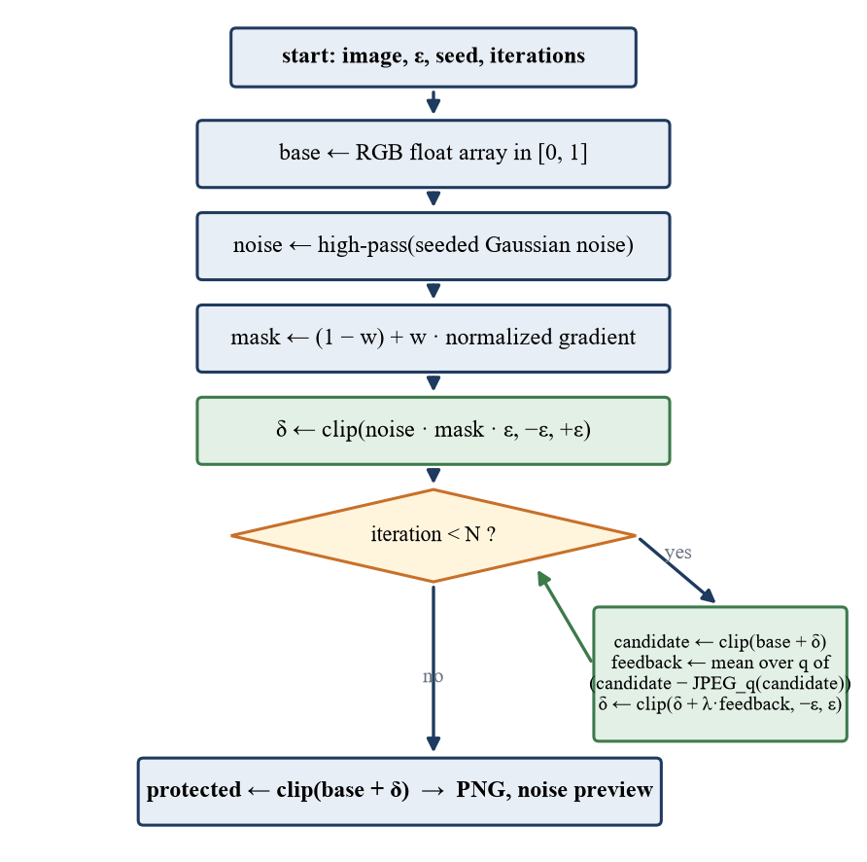
JPEG feedback loop
Candidate = clip(original + δ)
Compress it at each chosen quality; average what JPEG removed: f = mean(candidate − JPEG_q(candidate))
Update δ ← clip(δ + λ·f, −ε, +ε), with λ = 0.16
Repeat N times (default 4); uses the real JPEG encoder, no gradients
Side effect, measured later: the loop adds energy, so PSNR falls as iterations rise
CogniShield | BITE497J Project I | VIT Vellore
17

Slide 18
How quality is measured
Measure | Good direction | Meaning
PSNR | Higher | 10·log10(1 / MSE); above 30 dB usually means low visible distortion
SSIM | Closer to 1.0 | Local luminance, contrast and structure similarity
MSE | Lower | Mean squared pixel error on the 0–1 scale
Mean abs. delta | Lower | Average per-pixel change
Max abs. delta | Lower | Largest change; equals the budget here
The protected image is also JPEG-compressed at 95, 75 and 50 and compared with the original.
CogniShield | BITE497J Project I | VIT Vellore
18

Slide 19
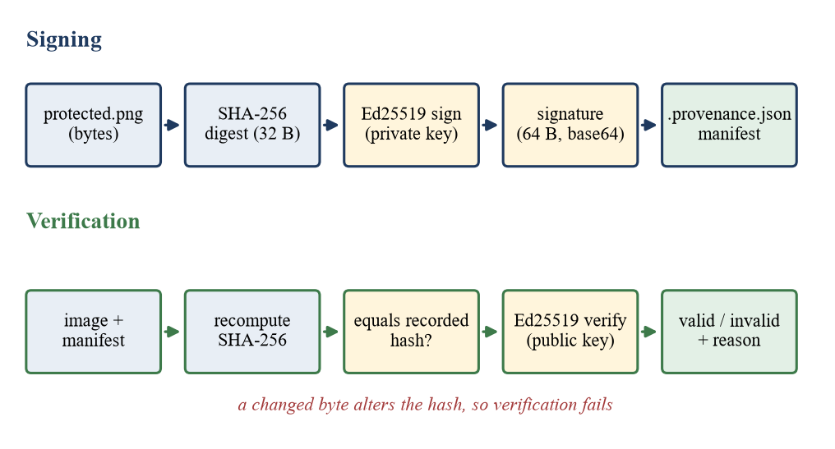
Signed provenance
SHA-256 of the protected PNG bytes
Ed25519 signature (64 bytes), saved in a JSON manifest
Verification recomputes the hash first, then checks the signature
Proves the bytes match what was signed; says nothing about whether the scene is real
CogniShield | BITE497J Project I | VIT Vellore
19

Slide 20
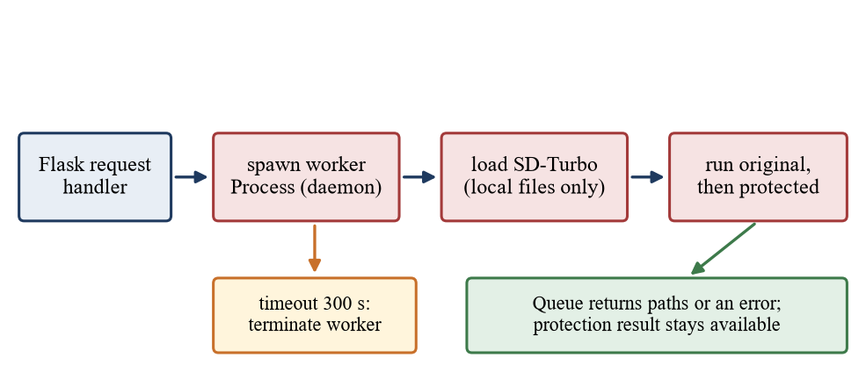
Optional SD-Turbo test
Image-to-image, strength 0.55, guidance 0, longest side 512 px
Same prompt and seed for original and protected
Runs in a separate process with a 300 s timeout
If the model fails, the signed protection result is still returned
CogniShield | BITE497J Project I | VIT Vellore
20

Slide 21
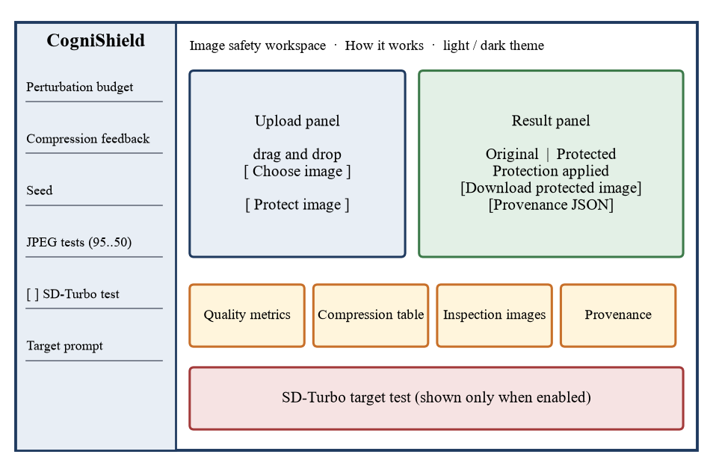
Demonstration: web interface
Drag and drop an image
Set budget, feedback, seed, JPEG tests
Press Protect image
Compare images, read metrics and the JPEG table
Download the PNG and the manifest
Dark mode by default, light toggle
CogniShield | BITE497J Project I | VIT Vellore
21

Slide 22
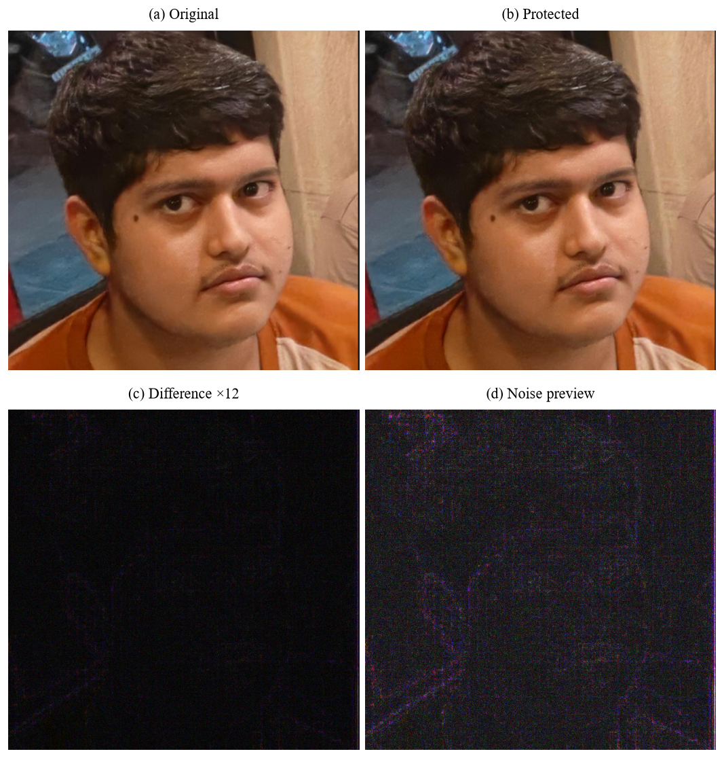
Demonstration: portrait run
Default settings: budget 8, 4 iterations, seed 42
PSNR 45.49 dB, SSIM 0.9831
Average pixel change about 1.00 level; maximum exactly 8 levels
Difference ×12 follows hair, eyes and clothing edges
After JPEG q=95 / 75 / 50: PSNR 45.12 / 42.10 / 39.48 dB
CogniShield | BITE497J Project I | VIT Vellore
22

Slide 23
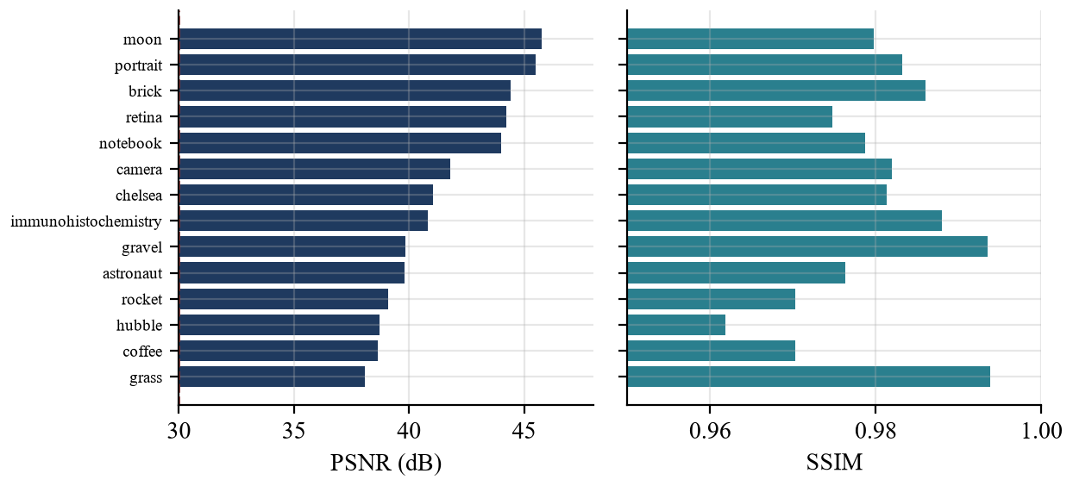
Results: how visible is the change?
14 images, default settings
Mean PSNR 41.56 dB (range 38.07 to 45.78)
Mean SSIM 0.9800 (lowest 0.9618)
All 14 above 30 dB and above 0.95
Max change exactly 8 levels in every image
CogniShield | BITE497J Project I | VIT Vellore
23

Slide 24
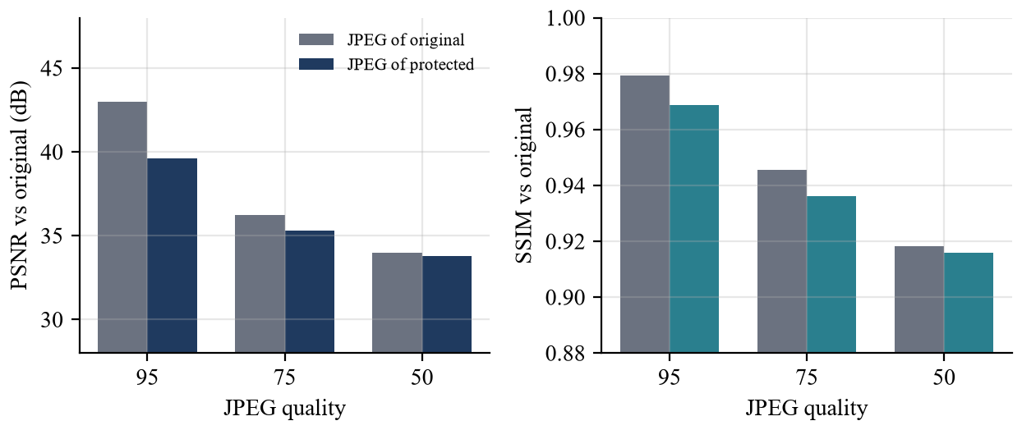
Results: after JPEG compression
Protected vs original JPEG: PSNR gap 3.37 / 0.94 / 0.16 dB at q = 95 / 75 / 50
Compression error swamps the perturbation as quality drops
Median retention of the perturbation: 0.60 / 0.50 / 0.17
About half survives at 95 and 75; under a fifth at 50
CogniShield | BITE497J Project I | VIT Vellore
24

Slide 25
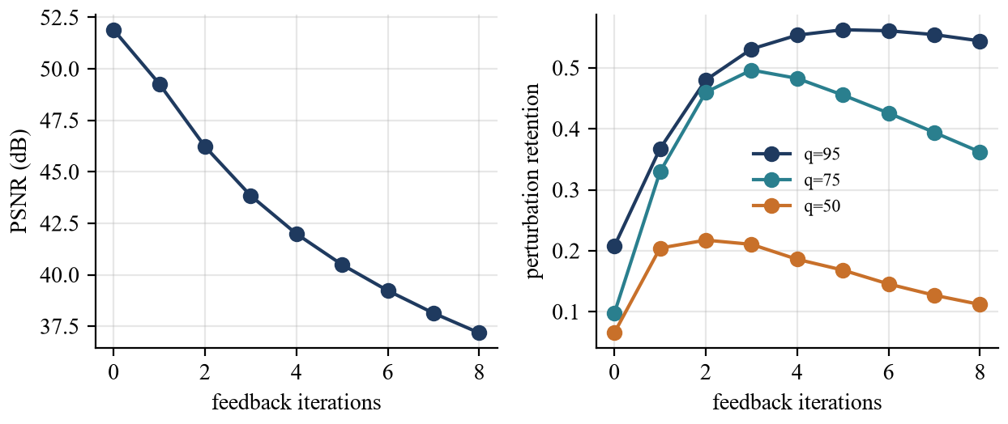
Results: feedback iterations and budget
Feedback raises retention at q=95 from 0.21 to 0.55, at q=75 from 0.10 to 0.48
It costs about 9.9 dB of PSNR over 4 iterations
Benefit peaks at 3 to 5 iterations, then falls
Budget 1 to 16: PSNR 50.25 to 39.06 dB
Suggestion: 3 iterations may be a better default
CogniShield | BITE497J Project I | VIT Vellore
25

Slide 26
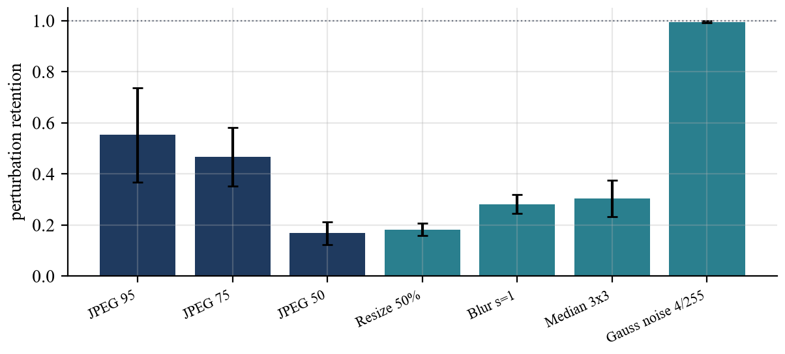
Results: other edits, and the final perturbation
Resize 50% keeps 0.18, blur 0.28, median filter 0.30 of the perturbation
Initial noise averages only 0.49 levels; the final perturbation 1.62 levels
Final perturbation tracks the image's own JPEG residual (correlation 0.75) more than the seeded noise (0.49)
Only 1.7% of pixel values reach the budget
CogniShield | BITE497J Project I | VIT Vellore
26

Slide 27
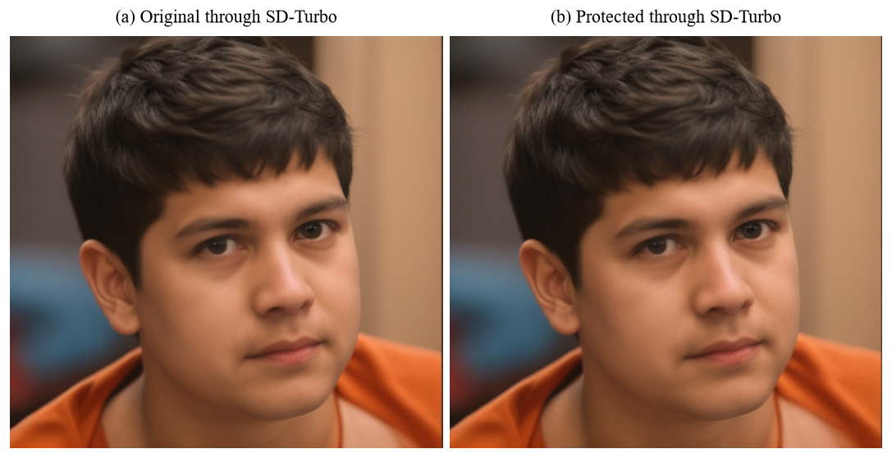
Results: effect on SD-Turbo
Outputs for original and protected look almost identical
PSNR between outputs 41.06 dB, SSIM 0.9863
Between the inputs it was 45.49 dB
No visible disruption of SD-Turbo at default settings
One image, one prompt, one seed; the harness works, the defence does not yet
CogniShield | BITE497J Project I | VIT Vellore
27

Slide 28
Results: provenance, repeatability and speed
Check | Result
Recorded manifests whose SHA-256 matches the file | 18 of 18
Digest still matches after one flipped bit | 0 of 18
Same image, seed, settings twice | Bit-identical output
PSNR across 10 seeds (portrait) | 45.11 to 45.90 dB
Protection time, 512 × 512 / 1024 × 1024 | 0.19 s / 0.75 s
Average over the 14 test images | 0.27 s per image
CogniShield | BITE497J Project I | VIT Vellore
28

Slide 29
Limitations and future work
Limitations
No protective effect on SD-Turbo shown
Resizing, blur, median filter and JPEG q=50 remove most of it
Re-encoding invalidates the signature of the copy
Key is unencrypted; local key proves origin, not identity
14 images, one model test, no human study
Future work
Optimise the perturbation against the target model
Test face-swap and inpainting models
Perturbations robust to resizing and filtering
Add a robust watermark next to the signature
Open provenance standard, protected keys, on-device version
CogniShield | BITE497J Project I | VIT Vellore
29

Slide 30
Conclusion
A complete local pipeline: perturb, measure, test JPEG, sign, verify
Meets the goals for imperceptibility, boundedness, reproducibility and integrity
Honest result: not yet a proven defence against a diffusion editor
Value: a transparent baseline for stronger, model-aware protection
CogniShield | BITE497J Project I | VIT Vellore
30

